Slide 1
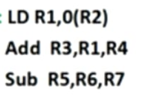
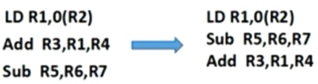
Scheduling ordering the execution of instruction in a program to improve the instruction
Static scheduling (Software based approach) compiler optimized the code, it does not lead to improvement in performance. This scheduling follows in order execution.(RAW)
Dynamic Scheduling (Hardware Based Approach) We rearranges the instruction to reduce the stalls while maintaining the data flow problem (WAR,WAW) due to out of order instruction

Slide 2
Scoreboarding
Schemes of implementing Dynamic Scheduling
Scoreboarding
Tomasulos’s Algorithm (More efficient than scoreboard)
Instruction scheduling algorithm.
It allows to execute out of order instruction when there are sufficient resources (no structural hazards) and no data dependencies (data hazard)

Slide 3
Parts of Scoreboarding
In scoreboarding we have 3 Parts
Instruction status (Current status of the instruction) from stages
Functional Unit status It has busy field which tells weather functional unit is busy or not Op field which tells operation to be performed Fi field destination register Fj and Fk field the source register Qj and Qk functional unit going to produce source register Fj and Fk Rj and Rk Flags indicating whether Fj and Fk are ready or not
Register result status Indicates which functional unit will write the register

Slide 4
In Scoreboarding we have 4 stages of Scoreboard Control
Issue ( ID Stage 1) Here instruction is decoded if the functional unit is free (no structural hazard) and no previously stalled instruction has the same destination register (no WAW dependency),the scoreboard issue the instruction
Read operands ( ID Stage 2) A source operand is available or we can read a source operand if no earlier stalled instruction is going to write.(Scoreboard resolve RAW hazard dynamically in this stage).When the source operand is available the scoreboard tells the functional units to proceed to read operands from the registers and begin execution.
Execution ( EX ) operation is performed on operands. When result is ready control signal is sent to the scoreboard
Write Back Once the scoreboard is aware that the functional unit has completed its execution it checks for WAR hazard, if none it writes the result. If WAR hazard exists then it stalls the instruction

Slide 5
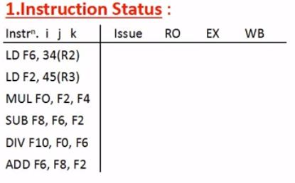
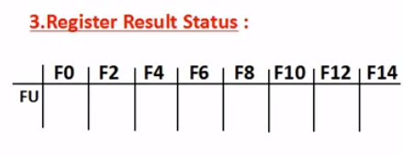
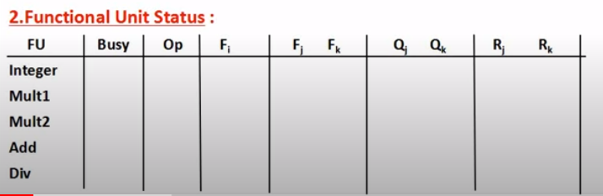

Slide 6
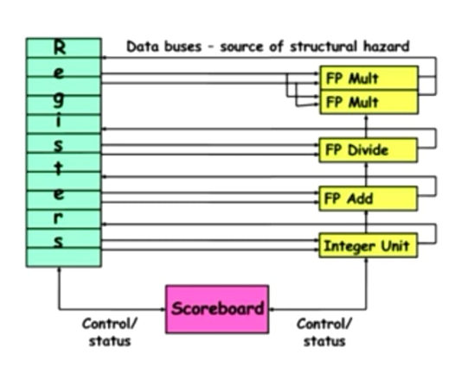
Every instruction goes through centralized hardware scoreboard
The scoreboard sends control signal to tell when an instruction can execute and when it can write results into destination register
Out of order execution requires multiple instruction in the EX stage simultaneously which can be achieved with multiple functional units
Instruction having dependencies are stall but instruction having no dependencies are allowed to continue

Slide 7
Example
Div F0 F2 F4 Add F6 F2 F8 Sub F8 F10 F12
We have WAR dependency b/w add and sub instruction Let EX stage of sub instruction is completed before Add instruction but to resolved WAR hazard for F8,the sub instruction will be stalled until add instruction does not read the data from F8

Slide 8
Modules Interconnecting With scoreboard
Register File
Memory
Functional Units
Instruction Decode
Instruction Fetch

Slide 9
Architecture Of scoreboarding
http://www.icsa.inf.ed.ac.uk/cgi-bin/hase/dlx-scb.pl?dlx-t.html,dlx-f.html,menu.html

